Slide 1
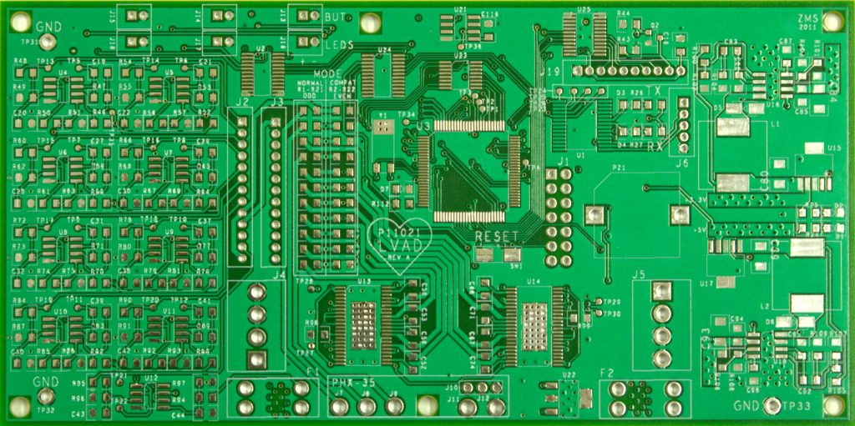
Architectures, CPUs and the FDE cycle
Execute
Decode
Fetch

Slide 2
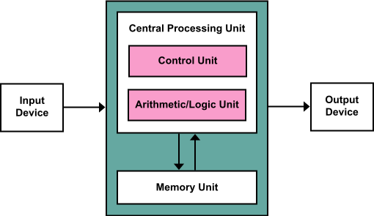

Von Neumann’s Computer design ‘Architecture’

Slide 3
Harvard Architecture
Instructions
Data
CPU

Slide 4
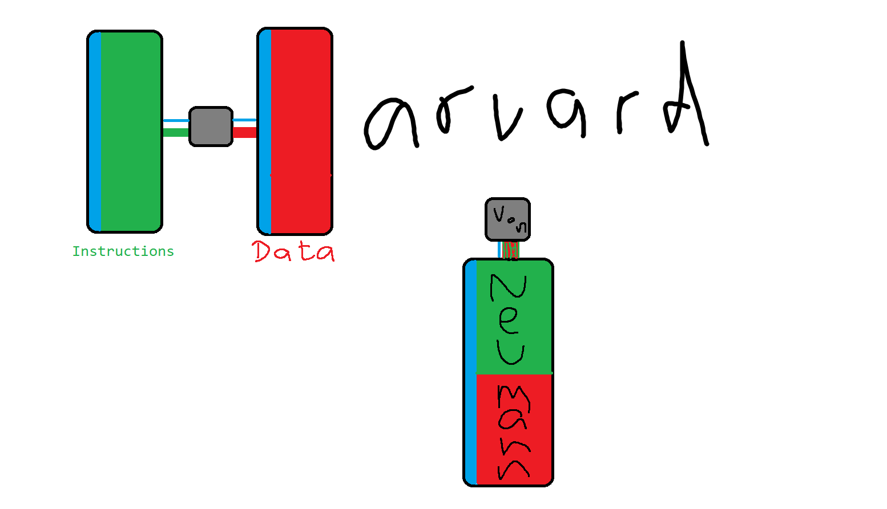

Slide 5
VN
Harvard
separate memory units and buses for instructions and data
Instructions and data can be accessed simultaneously
Take fewer clock cycles to execute instructions
Take fewer clock cycles to execute instructions
Same memory unit for instructions and data
Has control unit
Has arithmetic logic unit
PCs use this
Instructions might be on ROM
Embedded devices use this
Is synchronised with a clock signal
Has registers to store instructions / data

Slide 6
The FDE cycle
Fetch an instruction…
Decode the instruction…
Execute the instruction…
Execute
Decode
Fetch

Slide 7
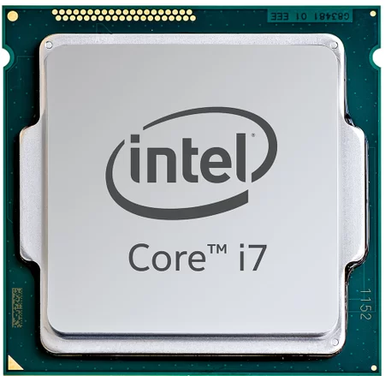
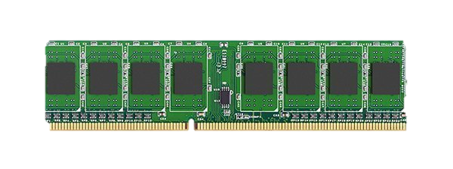
Execute
Decode
Fetch
CPU
Control Unit
REGISTERS
Program Counter
Memory Address Register
Memory Data Register
Instruction Register
Accumulator
CPU BUS
Arithmetic / Logic Unit
to I/O devices
To storage devices
Control bus
Address bus
Data bus
Memory
Address | 0 | 1 | 2 | 3 | 4 | 5 | 6
Data | LOAD 4 | ADD 5 | STORE 6 |  | 4 | 7

Slide 8
Execute
Decode
Fetch
CPU
Control Unit
REGISTERS
Program Counter
Memory Address Register
Memory Data Register
Instruction Register
Accumulator
CPU BUS
Arithmetic / Logic Unit
to I/O devices
Address bus
Data bus
To storage devices
Control bus
Data bus
Memory
Address | 0 | 1 | 2 | 3 | 4 | 5 | 6
Data | LDA 4 | ADD 4 | STA 5 | HLT | -21

Slide 9
The FDE cycle…
Execute
Decode
Fetch
Fetch an instruction…
Decode the instruction…
Execute the instruction…
This can be slow for various reasons (👀VNB)
Mitigations:
Prefetch instructions and data into cache
Pipelining (doing FDE stages in parallel and lining up instructions)

Slide 10
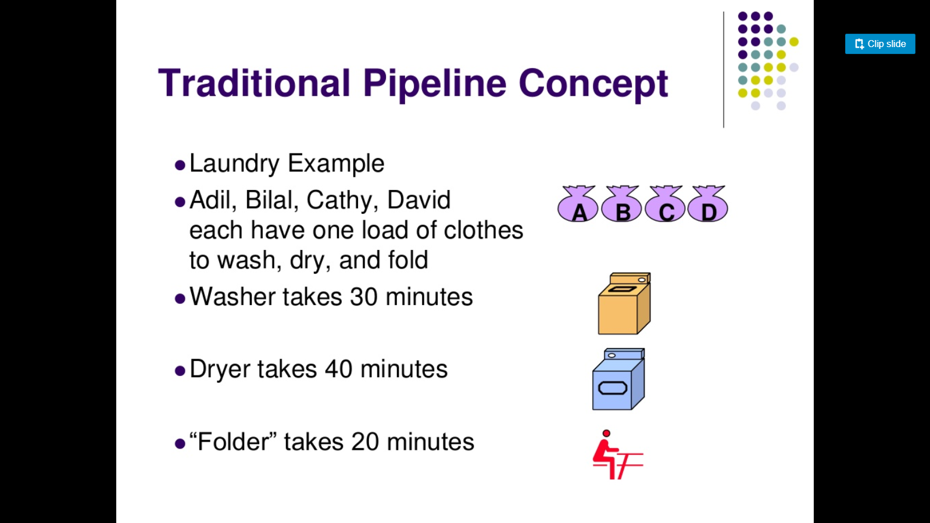

Slide 11
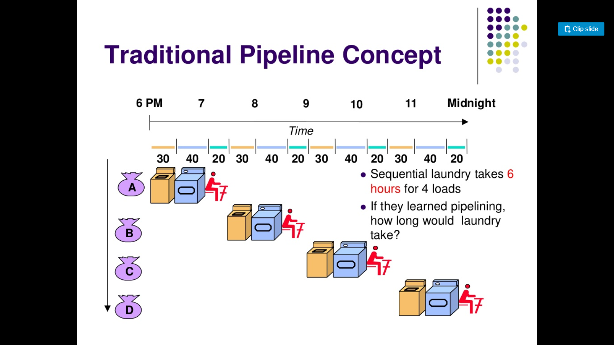

Slide 12
